Slide 1
Mid-Module Assignment R v. Vachon-Desjardins, 2022 ONCJ 43
University of Essex Principles of Digital Forensics and Cyber Law August 2022
Ying Chan

Slide 2
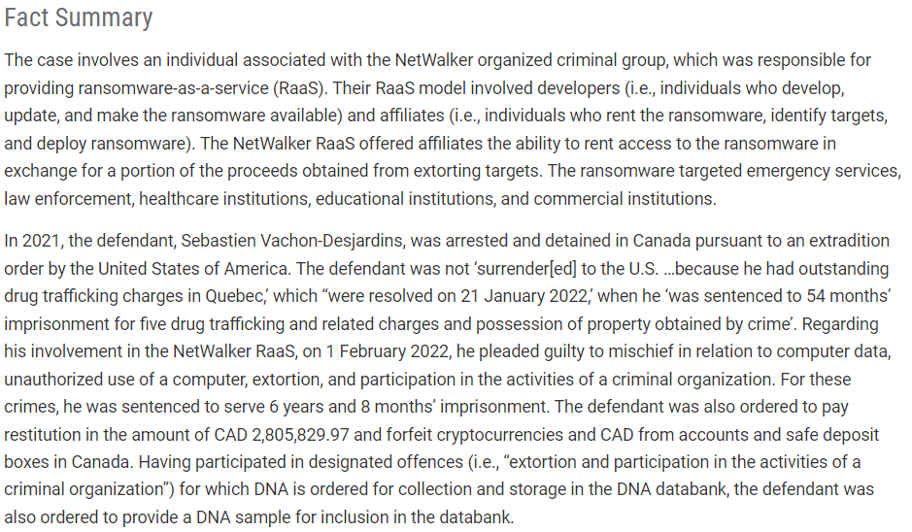
R v. Vachon-Desjardins, 2022 ONCJ 43 Summary
(UNODC, 2022)

Slide 3

1. The country chosen and the reason it was chosen.
Canada’s case (UNODC, 2022)
The case was ended recently in 2022 providing the updated cybercrime methodology and technology.
This is possibly the first ransomware case on this large scale in Canada.
Canada’s legal system (Department of Justice Canada, 2021)
Based on a combination of common law and civil law.
The criminal code is also considered a code, and it is used throughout Canada.

Slide 4
2. The cybercrime chosen, as well as the reason it was chosen and the context (a small comparison with another country could be added).
Ransomware
Cross-Cutting country (Bulgaria, Canada and USA)
Cryptocurrency
It is perfectly legal in Canada and United States of America
9 countries where Bitcoin is banned (i.e. Nepal), 8 countries where use of Bitcoin is legally restricted (i.e. China) (Cryptonews, 2022)
Participation in activities of criminal group (NetWalker)
Ransomware-as-a-service (RaaS)
Criminal group organization

Slide 5
3. A description and explanation of the chosen cybercrime (type, nature).
Ransomware (type of malicious software, or malware)
Phishing
Exploiting
Compromising accounts
Extortion
Nature of ransomware
Cryptocurrency (i.e. Bitcoin) highly used by ransomware as it is hard to trace back
Targeted emergency services, public services, and commercial institutions
Participation in activities of criminal group (NetWalker)
Well organized and systematic
Group member (hired between 10-15 unknown individuals and teaching them the methods)

Slide 6
4. An analysis of the ways the chosen country has dealt with the chosen cybercrime - on a national and international level, legislation and other tools utilised.
Legislation / Statute / Code:
Section 430(5) of the Criminal Code
The defendant was charged under s. 430(5)(a) of the Criminal Code
Charge details:
Mischief in relation to computer data
Legislation / Statute / Code:
Section 342.1 of the Criminal Code
The defendant was charged under s. 342.1(1)(a) of the Criminal Code.
Charge details:
Unauthorized use of computer
Legislation / Statute / Code:
Section 346(1.1) of the Criminal Code
The defendant was charged under s. 346(1.1)(b) of the Criminal Code.
Charge details:
Extortion (two counts)
Legislation / Statute / Code:
Section 467.11 of the Criminal Code
Charge details:
Participation in activities of criminal organization
In August 2020, the RCMP received information from the American FBI in relation to a NetWalker ransomware affiliate operating in Gatineau Quebec.
However, the defendant had outstanding drug trafficking charges in Quebec, the RCMP applied for various court authorizations to further their investigation into the suspected activities of the defendant. (Paul, 2022)
Criminal Code
Section 430(5) - In R. v. Geller, [2003] O.J. No. 357 “hacking” after obtaining 400 credit card numbers
18 U.S. Code
18 U.S. Code § 1030 - Fraud and related activity in connection with computers
18 U.S. Code § 873 - Blackmail and extortion laws
(UNODC, 2022)

Slide 7
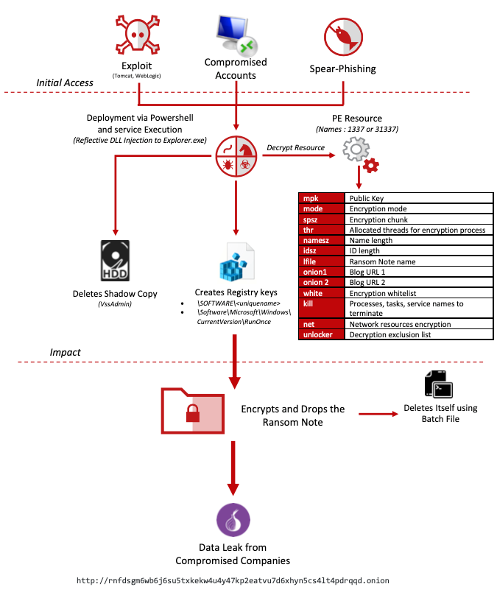
5. If available, identify the costs of this crime, and the extent of this affecting effective investigation.
Costs
Phishing – Email server
Exploit – The target hardware or software cost
Compromised accounts – Cost of social engineering
RaaS – Hosting servers
Hiring member – Share payment
Development - incalculable
Affecting investigation
Data encrypted
Routing of the attack source
Victim’s account owner
Not required expert hackers
Rapidly spread the ransomware far and wide
(McAfee, 2020)

Slide 8
6. If available, identify issues concerning crime investigation; focus on the gathering of evidence.
Based on IP addresses
[U.S.] Apple, Google, Microsoft, and Mega.nz accounts, aliases, email addresses.
[U.S.] Personal information discovered on social media platforms
The Defendant was identified by the Canadian authorities.
In January 2021, the police searched the Defendant’s home and bank accounts. Search warrants and general warrants to seize cryptocurrency resulted in many devices seized with approximately 20TB of data contained therein. If printed, would fill an entire hockey arena.
During an application to extend the detention of items seized, in the absence of any charges
The Defendant even improved upon the ransom messages and convinced the creator of NetWalker to use “mixing services” to disguise funds paid for ransoms in Bitcoin.
Defendant’s decision to cooperate with Canadian authorities, the police would not have charged the Defendant for several years while they sifted through the mountain of data to identify victims and searched for proof to mount a successful prosecution. (Paul, 2022)

Slide 9
7. A critical examination of public and social perception generally and in your chosen country. You can draw evidence from the ‘reader comments’ section in online news reels.
In the Canadian Enterprise Communications 2021 survey (Lawrence, S. et al., 2021)
67% of the 460 firms questioned reported that they had been victimized by ransomware in 2021.
On paying a ransom, 44% of respondents admitted that their company has done so.
In contrast, slightly under half of those that paid stated access to their encrypted data was only partially recovered, while 42% said that their business was able to fully restore its data using the decryptor offered. (Howard, 2021)

Slide 10
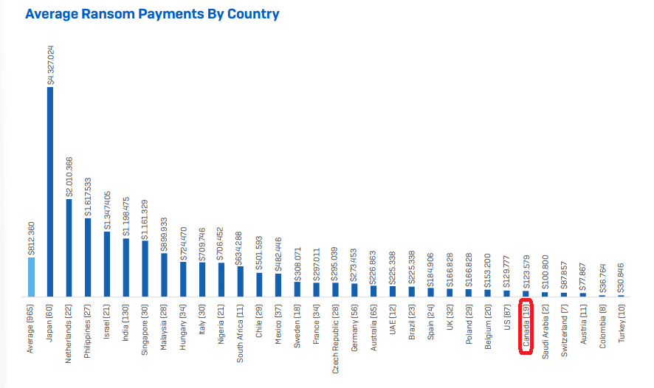
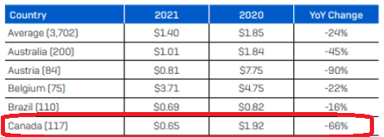
7. Continued
The State of Ransomware 2022 report (Sophos, 2022)
The Average Ransom Payments By Country, Canada is ranked 26 in the 31 countries.
The Average Cost to Organization to Rectify the Attack has been decreased US$1.27 Million (-66%) in 2021.

Slide 11
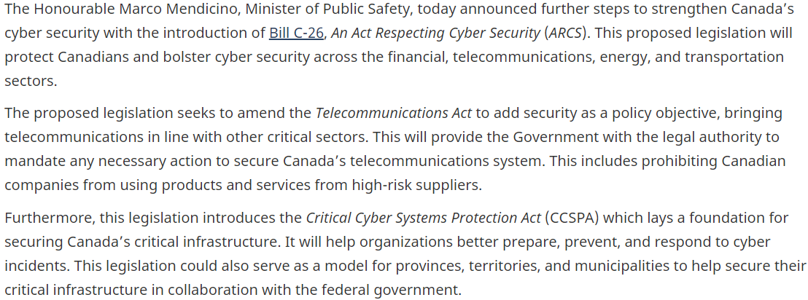
7. Continued
Canada’s cyber security legislation
(Government of Canada, 2022)

Slide 12
References
Cryptonews. (2022) Countries Where Bitcoin Is Banned or Legal In 2022. Guides. Available from: https://cryptonews.com/guides/countries-in-which-bitcoin-is-banned-or-legal.htm [Accessed 17 Sep 2022].
Department of Justice Canada. (September 1, 2021) Where our legal system comes from. About Canada's System of Justice. Available from: https://www.justice.gc.ca/eng/csj-sjc/just/03.html [Accessed 17 Sep 2022].
Government of Canada. (June 14, 2022) Government introduces new legislation to protect Canada's cyber security. Public Safety Canada. Available from: https://www.canada.ca/en/public-safety-canada/news/2022/06/government-introduces-new-legislation-to-protect-canadas-cyber-security0.html [Accessed 17 Sep 2022].
Howard, S. (November 5, 2021) Sixty-seven per cent of Canadian firms surveyed were hit by ransomware in last 12 months. Security. Available from: https://www.itworldcanada.com/article/sixty-seven-per-cent-of-canadian-firms-surveyed-were-hit-by-ransomware-in-last-12-months/464245 [Accessed 17 Sep 2022].
Justice Paul, G. (February 1, 2022) R. v. Vachon-Desjardins, 2022 ONCJ 43. Brampton 3111 998 22 237. Available from: https://www.canlii.org/en/on/oncj/doc/2022/2022oncj43/2022oncj43.html [Accessed 17 Sep 2022].
Lawrence, S. et al. (December 2021) Canadian Enterprise Communications 2021 Survey Results. IDC Survey - Doc # CA47056621. Available from: https://www.idc.com/getdoc.jsp?containerId=CA47056621&pageType=PRINTFRIENDLY [Accessed 17 Sep 2022].
Martin, B. (May 2, 2022) Ransomware Study 2022: attacks are up, ransom payments are increasing. Security. Available from: https://www.ghacks.net/2022/05/02/ransomware-study-2022-attacks-are-up-ransom-payments-are-increasing/ [Accessed 17 Sep 2022].
McAfee. (August 3, 2020) Take a "NetWalk" on the Wild Side. McAfee Labs. Available from: https://www.mcafee.com/blogs/other-blogs/mcafee-labs/take-a-netwalk-on-the-wild-side/ [Accessed 17 Sep 2022].
Sophos. (April 2022) The State of Ransomware 2022. Whitepaper. Available from: https://assets.sophos.com/X24WTUEQ/at/4zpw59pnkpxxnhfhgj9bxgj9/sophos-state-of-ransomware-2022-wp.pdf [Accessed 17 Sep 2022].
UNODC. (2022) R v. Vachon-Desjardins, 2022 ONCJ 43. Case Law Database. Available from: https://sherloc.unodc.org/cld//case-law-doc/cybercrimecrimetype/can/2022/r_v._vachon-desjardins_2022_oncj_43.html [Accessed 17 Sep 2022].

